Slide 1

Smart Pharmacy Inventory
AI-Powered Demand Forecasting & Stock Classification
Presented by: [Amna Bilal 09-239242-020]
[ Khadija Moeen 09-239242-050 ]

Slide 2
Project Overview
So1v1ng Rea1-Wor1d Hea1thcare Supp1y Chain Issues

Slide 3
_{I} The Problem We Solve
Medicine Shonages
When pharmacies run out of life saving drugs (Stock-outs), patient lives are put at risk. Our AI ensures we order before we run out.
Medicine Wastage
Buying too much stock leads to expired medicines and financial loss. We calculate the exact need to reduce wastage.

Slide 4
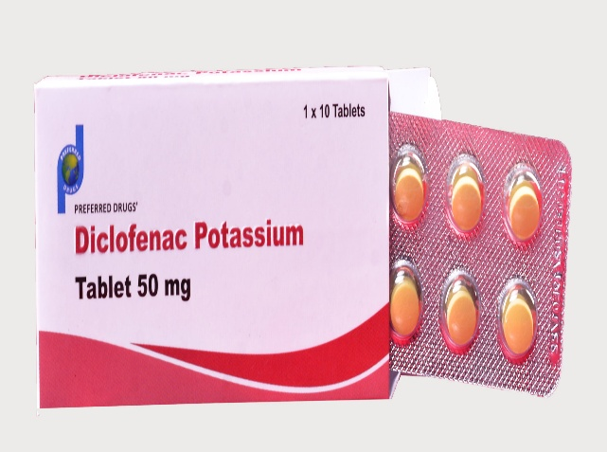
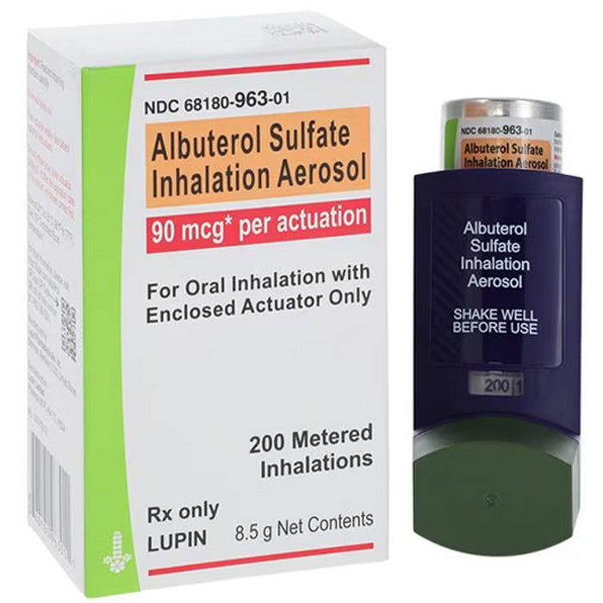
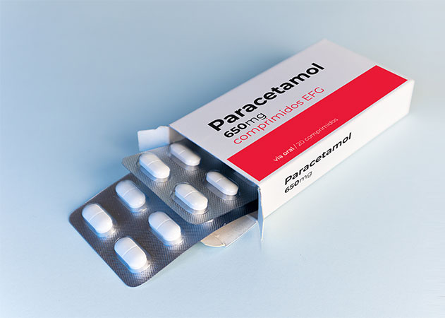
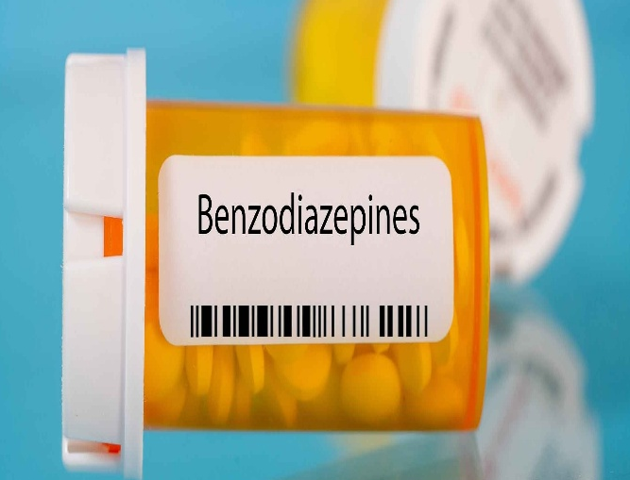
I Understanding the Data
We analyze 6 years of pharmaceutical sales data across 8 major categories ( Anatomical Therapeutic Chemical-ATC Codes):
M01AB/AE: Pain & Inflammation drugs
R03/R06: Allergy & Asthma medications
N05B/C: Anxiety & Sleep medicines
N02BE: Common Analgesics (Paracetamol)

Slide 5
I The Hybrid AI Approach
Data Prep
Cleaning 600,000+ records and extracting Year/Month features to capture seasonal trends.
Random Forest
An ensemble model that handles complex non-linear patterns much better than simple models.
Hybrid Output
Predicting both "How many units" (Regression) and "Stock Status" (Classification).

Slide 6
_{I} Performance Comparison
Mutiple Linear Regression Score
R2: 0.0549
Random Forest Score
R2: 0.8820
Polynomial Regression
R2: 0.1740
Random Forest outperforms traditional methods by capturing seasona/ spikes and dips effectively.

Slide 7
_{I} Classification Logic
Less than 50 units
Low
Minimum stock - No new orders.
50 to 150 units
Medium
Normal stock - Routine refill.
More than 150 units
High
Priority Stock - Bulk order required!

Slide 8
_{I} Model Reliability
Ready for Production:
68
Our model has been tested on unseen data to ensure it can predict future years (like 2026) with high confidence. It provides a solid decision-making foundation for pharmacy managers.
Testing Accuracy

Slide 9
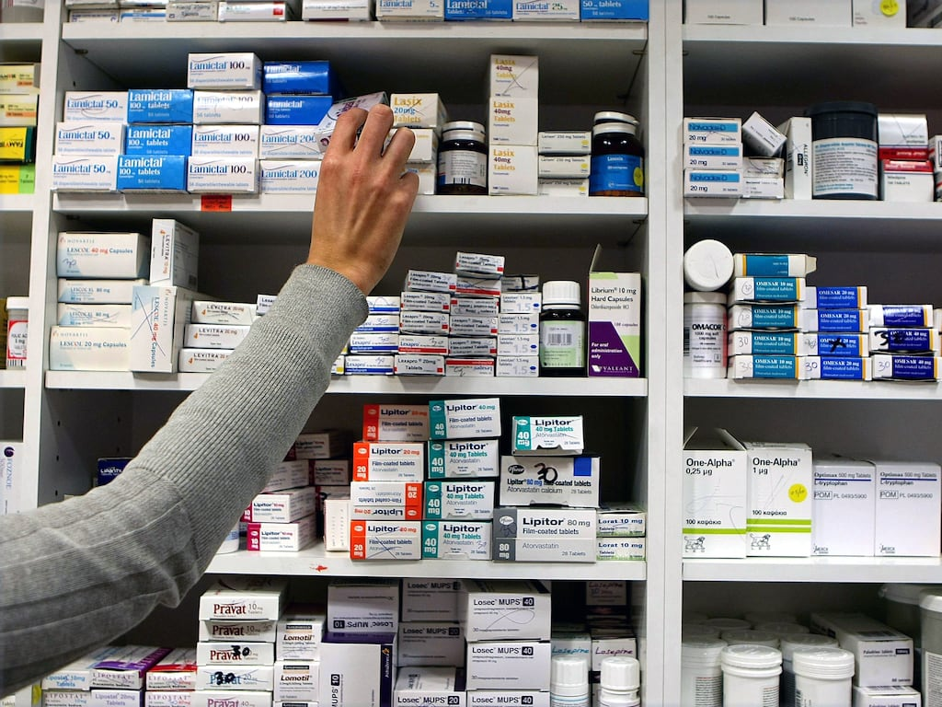
_{I} System Impact
Automated Alerts: High stock categories trigger instant buying signals.
Waste Reduction: Estimated 20% reduction in medicine expiration waste.
Smart Healthcare: A step towards fully automated, AI driven hospitals.

Slide 10
Thank You!
Ouestions & Discussion
AI-Driven Healthcare Logistics Management System

